Slide 1
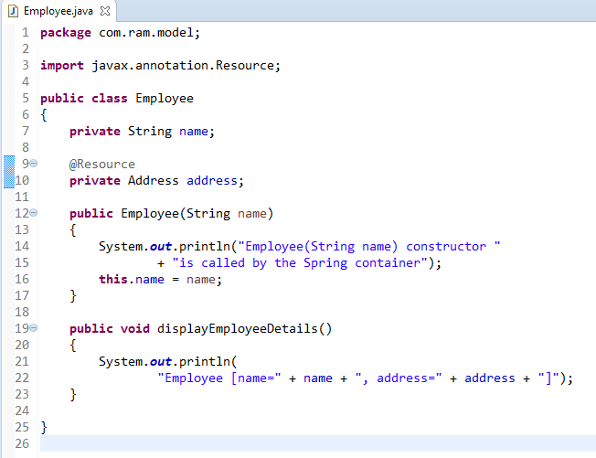
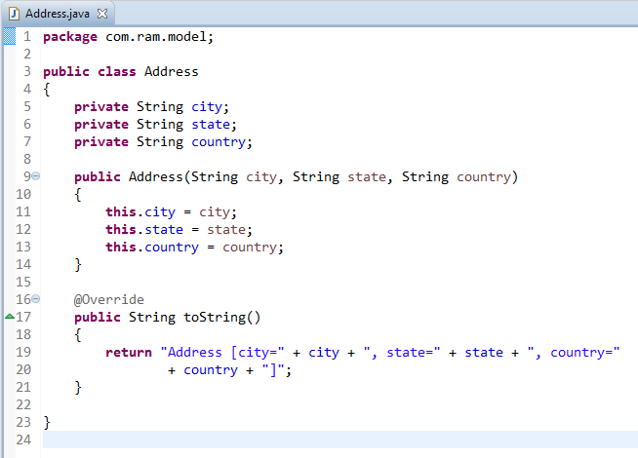
Spring Auto-Wiring Beans with @Resource annotation
The @Resource annotation is auto wire the bean by matching name.
We can use @Resource annotation to auto wire bean on the setter method, constructor or a field. Moreover, it can autowired property in a particular bean.
The @Resource annotation is part of the JSR-250 annotation collection and is packaged with Java EE.

Slide 2
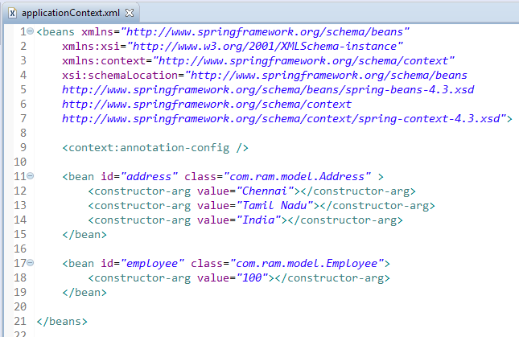
Spring Auto-Wiring Beans with @Resource annotation
To enable @Resource, you have to register ‘AutowiredAnnotationBeanPostProcessor‘, and you can do it in two ways.
Include <context:annotation-config />
Include AutowiredAnnotationBeanPostProcessor

Slide 3
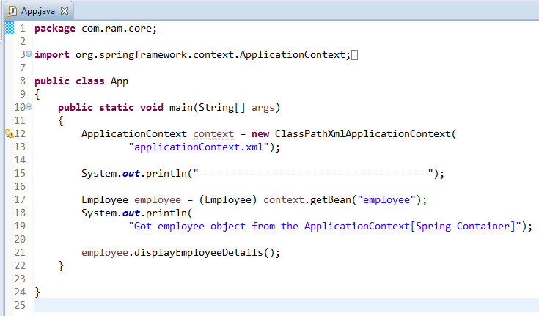
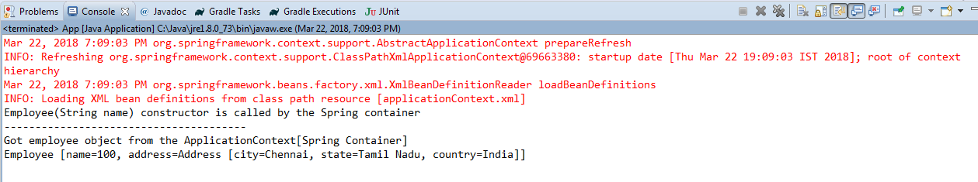
Spring Auto-Wiring Beans with @Resource annotation

